Slide 1

Welcome

Slide 2


Identity
Selina Akter
Asst.teacher
Bohoddar kata High School
Chakaria,Cox’s Bazar
E-mail: selikamal8485@gmail.com
Mobile:01815851776
ENGLISH FOR TODAY
CLASS : Nine

Slide 3
Let us enjoy a video
What do you mean by the video?

Slide 4
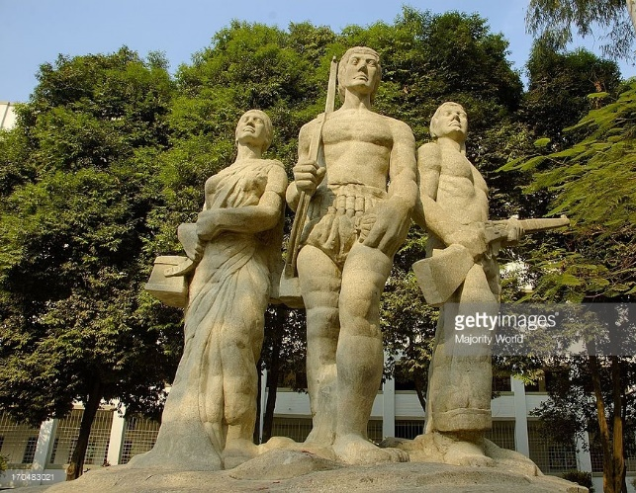
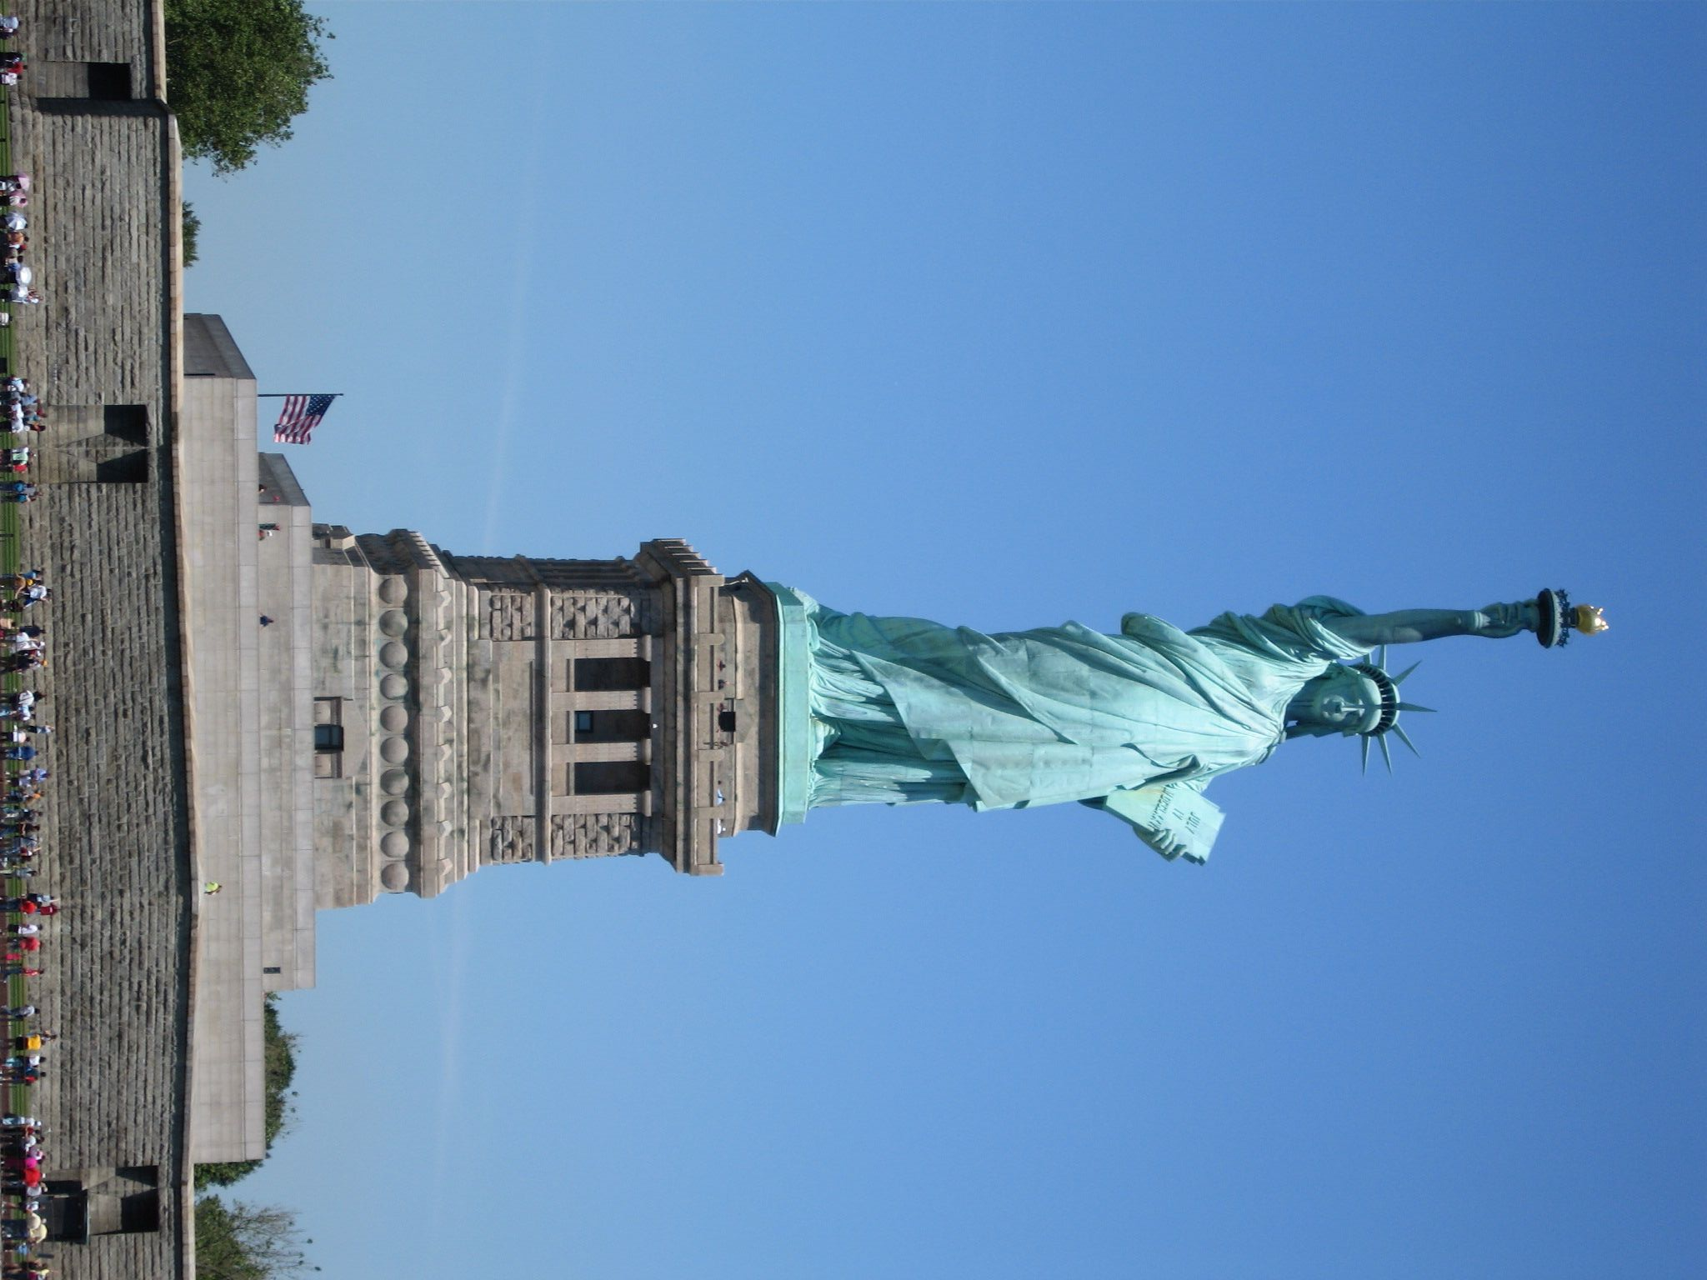
Lets see some pictures-
Aparajeo Bangla
Statue of Liberty

Slide 5
Our today’s lesson is-
Statue of Liberty
Unit-8, Lesson-3

Slide 6
Learning outcomes
By the end of the lesson, we will be able to-
ask and answer questions.
read and understand text through silent reading.
write short paragraph.

Slide 7

Key words
Gesture
sign
The girls are showing the victory gesture.

Slide 8
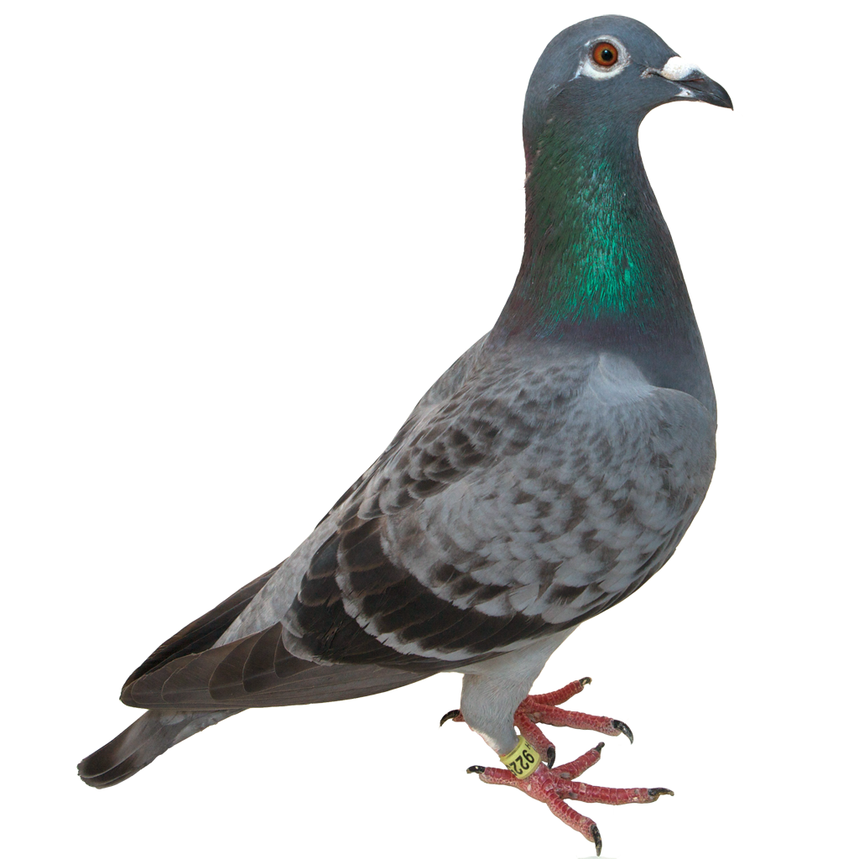
Symbolise
Stand for
Pigeon symbolises peace.

Slide 9
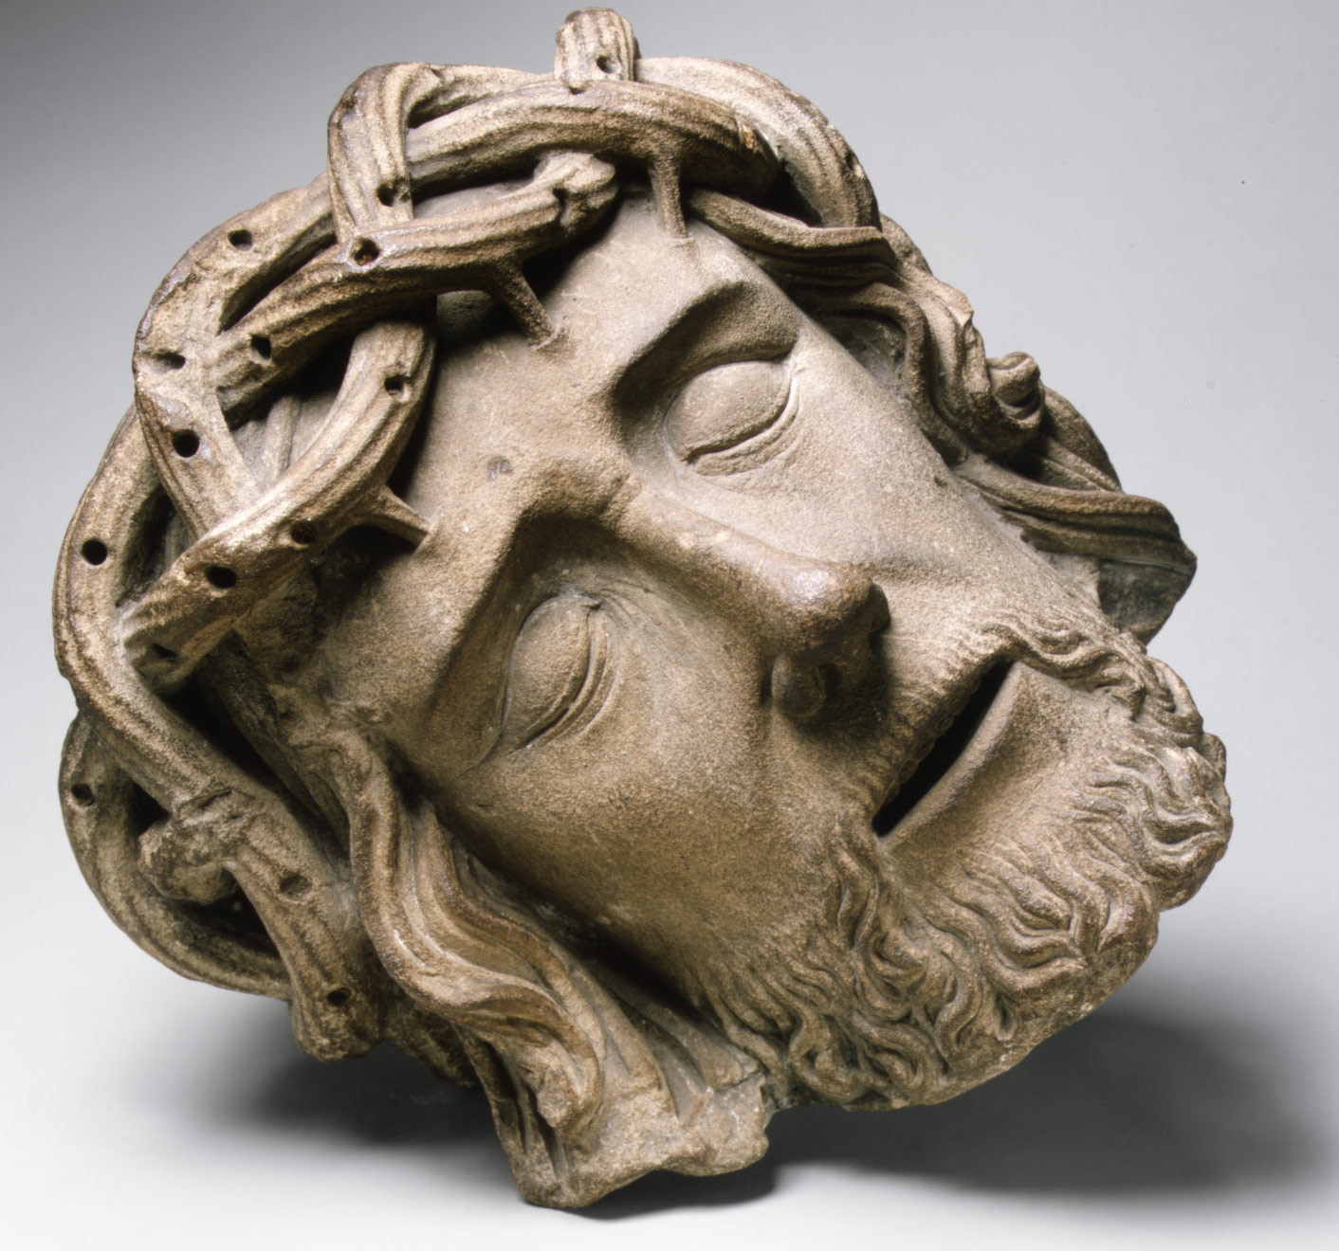
Sculpture
Craving,
statue
The Face in Medieval Sculpture.

Slide 10
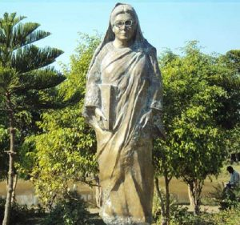
Enlighten
Make aware
Begum Rokeya Enlighten the society throughout her life.

Slide 11
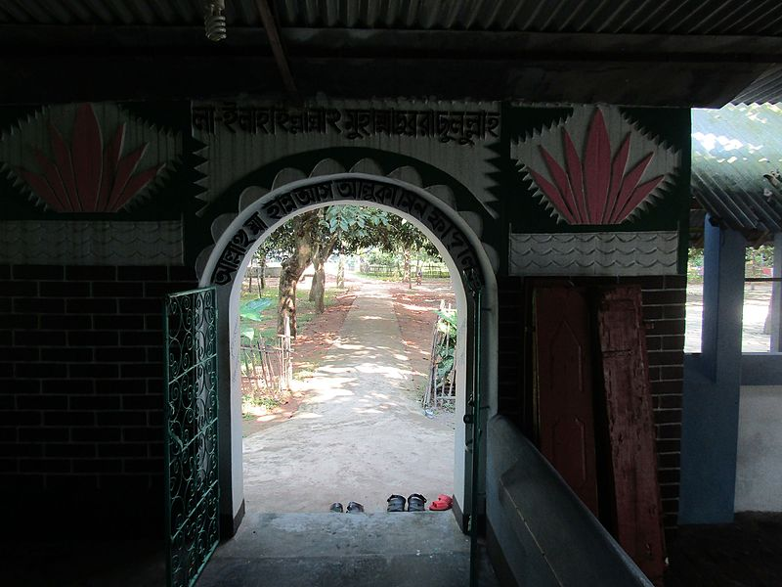
Access
entrance
This Access is very narrow.

Slide 12
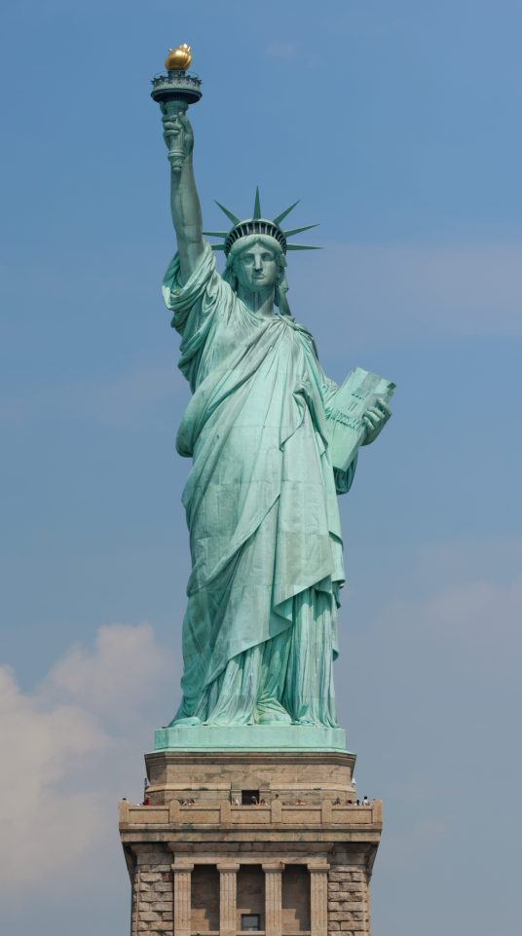
Look at the statue to identify different parts.
Torch
Spiked crown
Book inscribed
July 4,1776
Flowing robs

Slide 13


Listen to the text about the Statue of Liberty and complete the chart:
Pair work
Statue of Liberty | Information
Situated
Artist
Gift from
Reason for the gift
Presented on
Occasion
The statue symbolizes
Framework made of
Amount of copper used
Weight
Year of UNESCO World Heritage Site
Listen

Slide 14
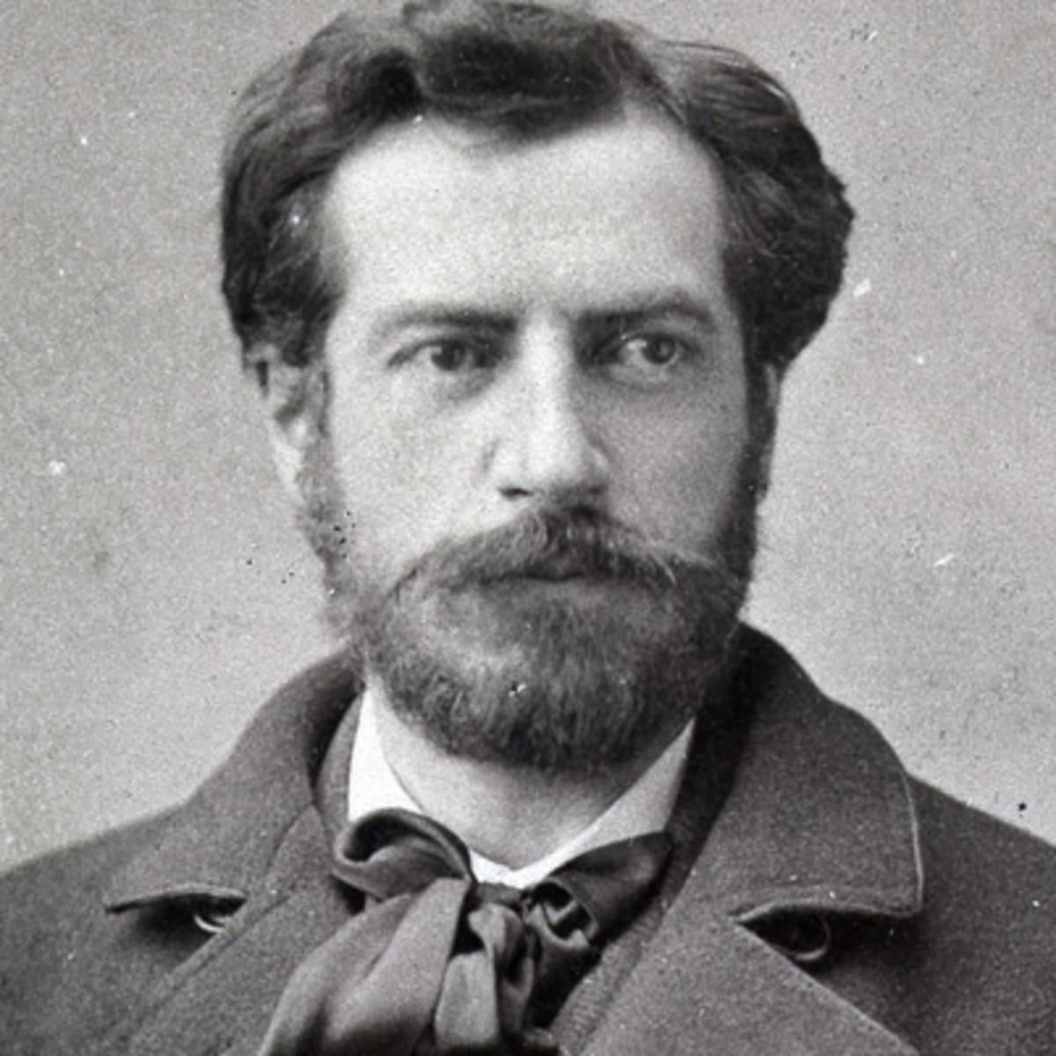
The statue was designed by the French
Sculptor
Frederic Bartholdi and was given by France to the United States.
Frederic Bartholdi

Slide 15
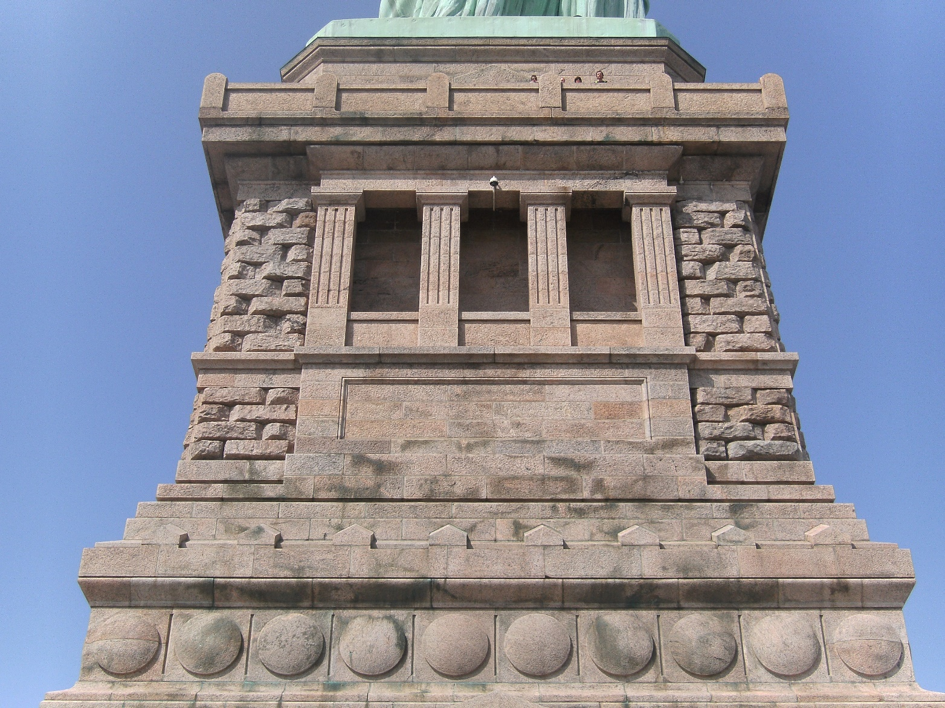
US donors financed the pedestal and installation of the monument. It was completed in August 1885.
Pedestal of the Statue

Slide 16
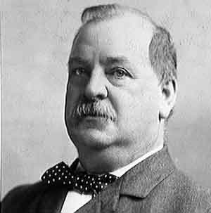
President Grover Cleveland dedicated the work on October 28, 1886.

Slide 17
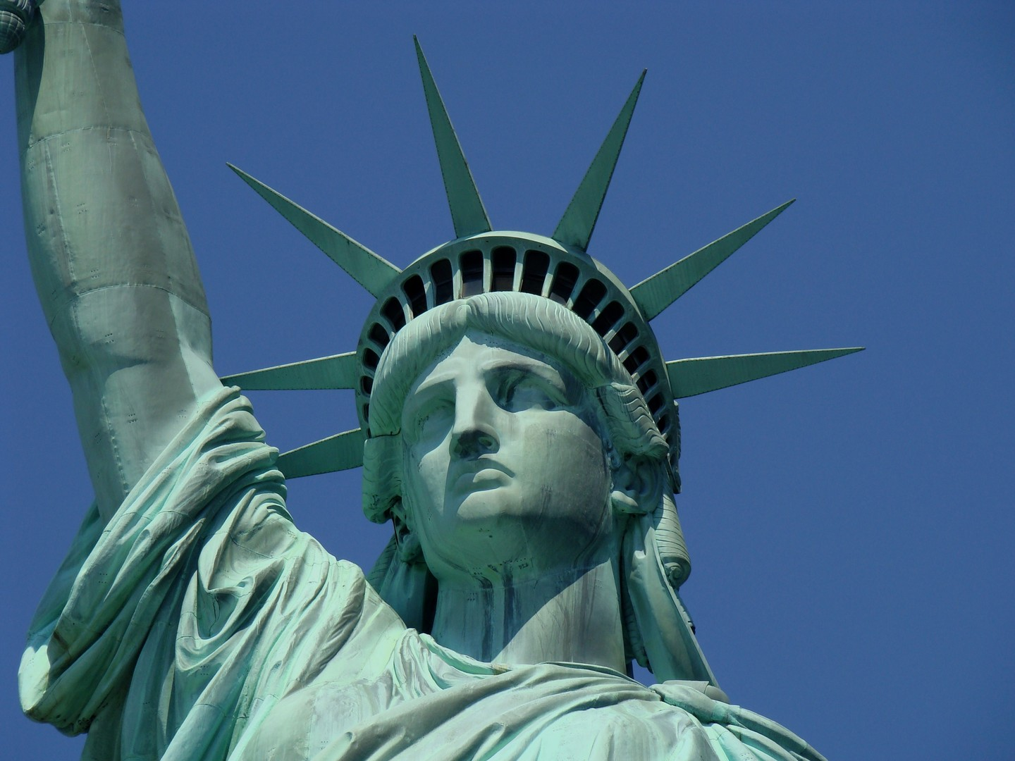
The head of the statue is reachable by staircase or emergency lift.

Slide 18
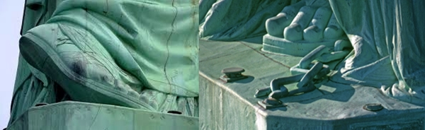
The Broken chain wrapped around her feet,protruding from the bottom of her robe,symbolizes her free forward movement,enlighteningn the world with her torch,free from oppression and slavery.

Slide 19
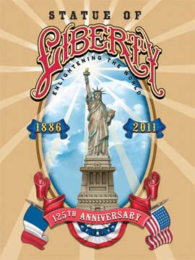
From October 28,2011 on her 125th anniversary,the Statue of Liberty was named “Liberty Enlightening the World Wide Web”.

Slide 20
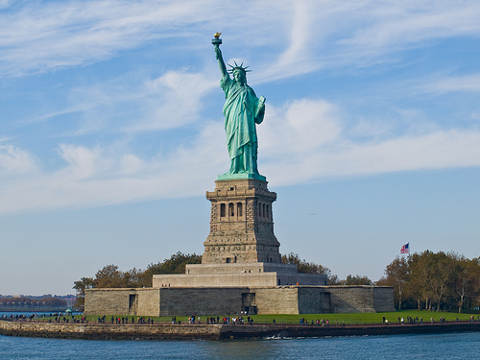
Measurement of the Statue of Liberty
The head from neck to diadem 28 feet
306 ft from torch tip to the pedestal
The
figure is 152 ft 2 in
The statue weighs 250 tons

Slide 21
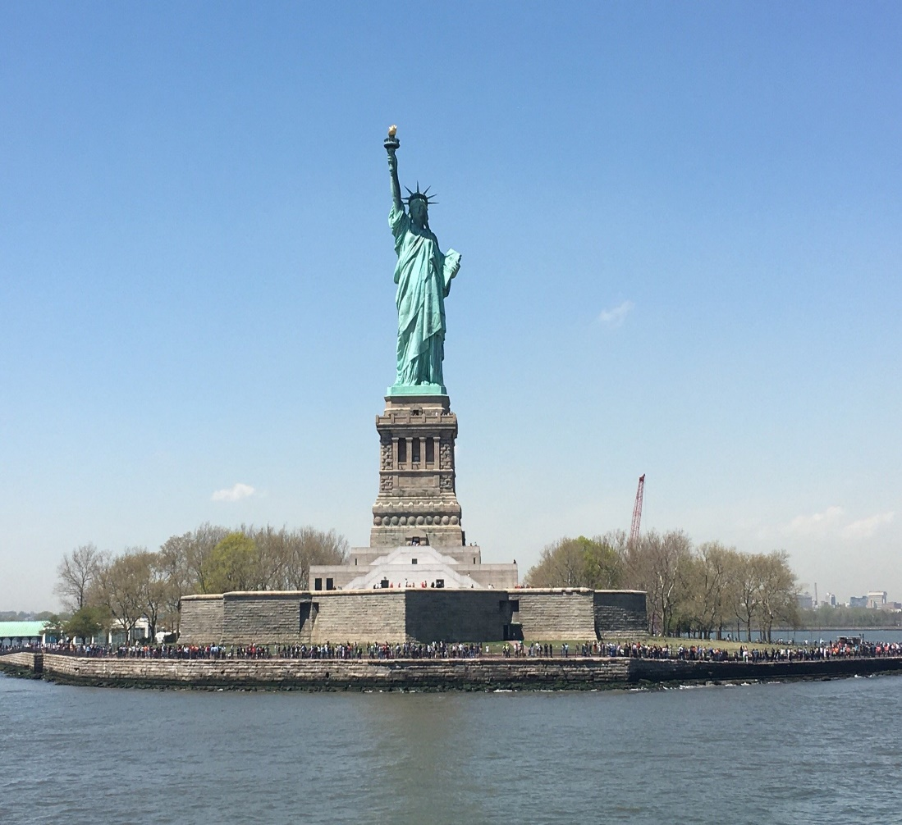
Pair work
A Look at the picture and talk about it in pairs.

Slide 22
Fill in the blanks with correct words from the box.
Group work
sculptor
flowing
liberty
aloft
designed
symbolises
situated
harbour
inscribed
crown
glorious
shaky
The Statue of Liberty is a)________________ on Liberty Island in the b)______________ of New York. The statue symbolises c)____________ in the form of a woman wearing d)______________robes and a spiked e)_____________. She holds a torch f)_____________ in her right hand and carries in her left hand a book g)____________ "July 4, 1776". Broken chains h)_________ the overthrow of tyranny. The statue was i)____________ by the French j)_________ Frederic Bartholdi .

Slide 23
Evaluation
1 On what occasion did the French govt. Give the Statue of Liberty to the USA?
2 Where is the Statue of Liberty?
3 Which country gave the statue as a gift?
On What occasion was it given?
What does the statue represent?

Slide 24

Home work
Write a paragraph on the ‘Statue of Liberty’ in 100 words.

Slide 25
Allah hafiz

